Slide 1
Rapid Fire Front-End

Slide 2
Expectations for Workshop
Be present, be engaged, and commit
Limit distractions: chats, emails, and other work can wait or be taken outside.
Engage with the activities and ask questions.
Be willing to share your work and learn from each other.

Slide 3

Setup

Slide 4
Ionic (Angular)
open terminal/commandline in folder you want to run your app
npm install -g @ionic/cli
ionic start
No to wizard
Framework = Angular
Project Name = Ionic Angular
Template = Blank
Standalone
Wait for install to complete
https://ionicframework.com/docs/

Slide 5
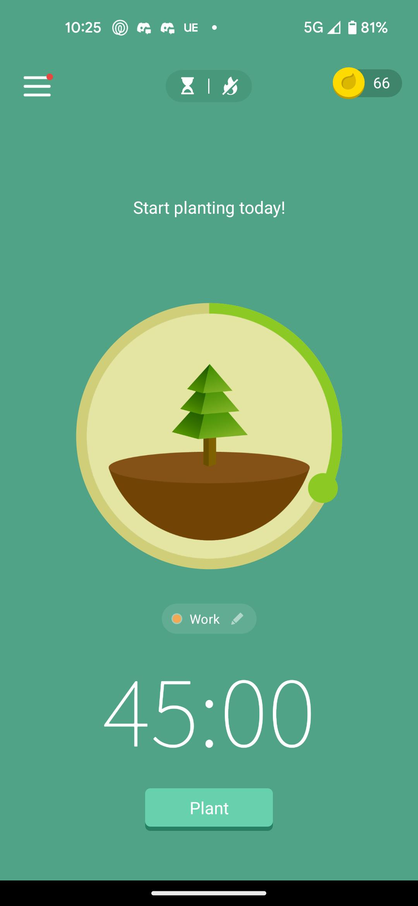
Circle Slider
Able to grab slider and see it animate around the circle

Slide 6
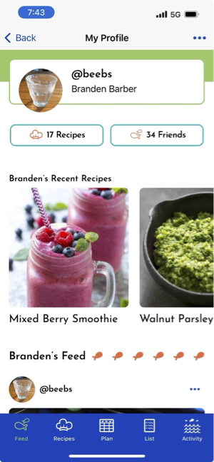
Scrolls both ways
Recent Recipes scrolls horizontally
Main page scrolls vertically

Slide 7
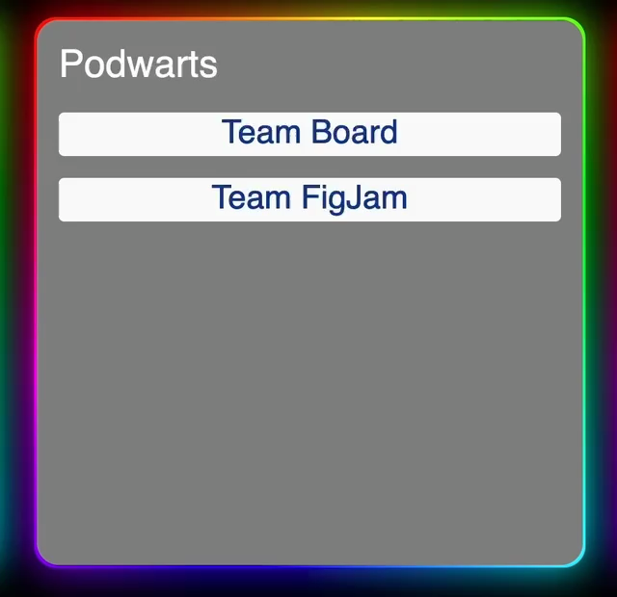
Animated Border
Gradient and animated and blue effect on an object’s border

Slide 8
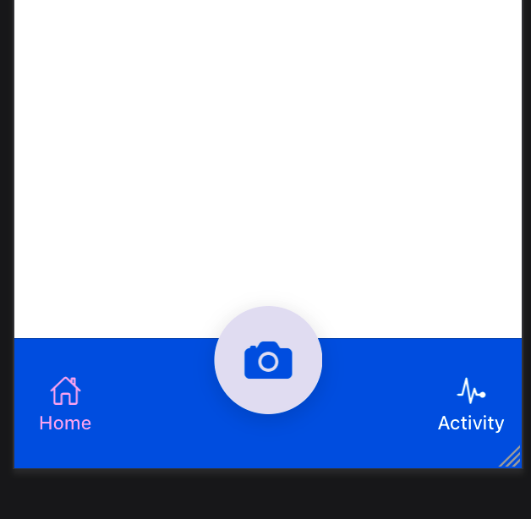
Breakout Circle
Camera button breaks out of the tab bar

